Slide 1
Miniature Wideband CP Antenna Based on Metaresontor and CRLH-TLs
EECS 531
Rishhabh Naik, William Ng,
Shrutija Ranganathan, Rohan Sequeira

Slide 2
Wideband CP Antennas for N78 using SRR and CRLH-TL
Overview:
1) Designed a novel V-SRR using metallic sheets to support the SRR structure.
2) Realized LP V-SRR antenna
3) Realized CP single port V-SRR antenna
4) Used CRLH-TL to realize CP two port V-SRR

Slide 3
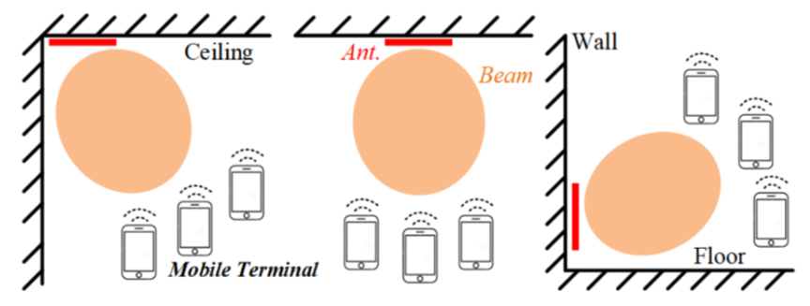
Application
5G New Radio (NR) is the global standard for a unified, more capable 5G wireless air interface.
Operating band (3.3 to 3.8 GHz) - N78 band
Challenge : Antennas with wide frequency band suffer from a larger dimension.

Slide 4
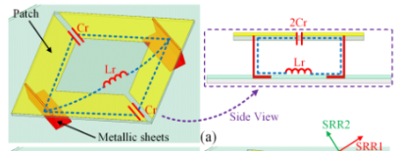
V-SRR
A novel V-SRR is realized by metallic sheets and a thin substrate.
Wider range variation of B.W. compared to conventional planar SRRs .
Resonant freq can be controlled using length and width.
Notes:
Used to produce the desired magnetic susceptibility (magnetic response) in various types of metamaterials up to 200 terahertz.
SRR’s produce negative μ and a wire array (or capacitively loaded strips)

Slide 5
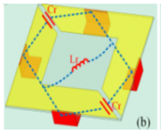
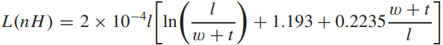
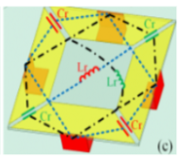
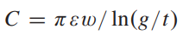
V-SRR’s II and III

Slide 6
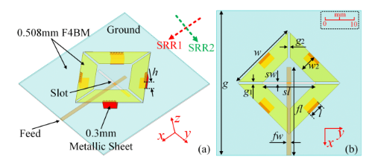
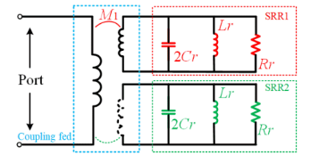
LP Antenna
Equivalent model of the LP Antenna

Slide 7
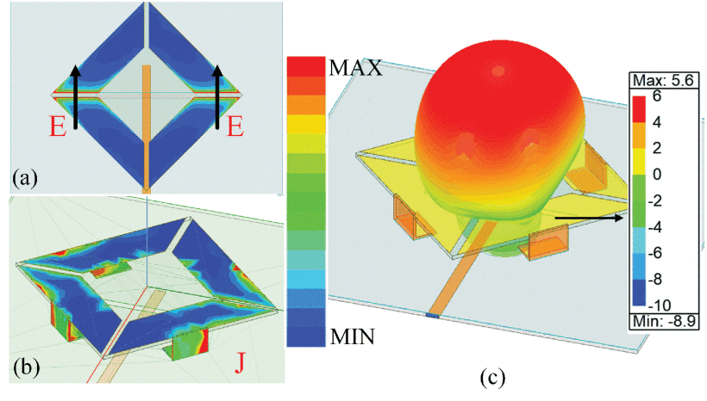
Author’s Simulation

Slide 8
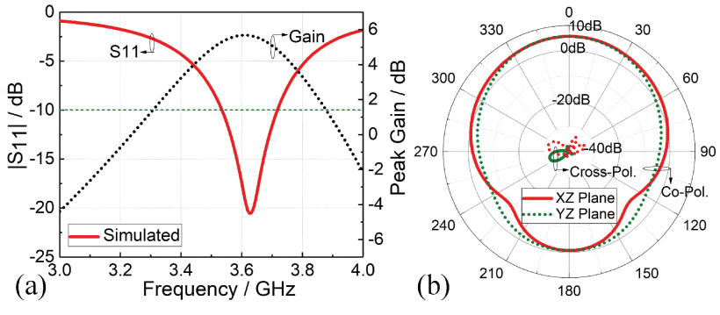
Author’s Simulation

Slide 9
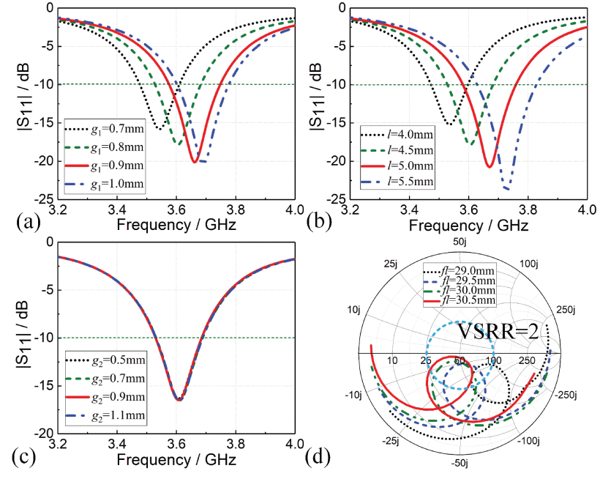
Author’s Simulation

Slide 10
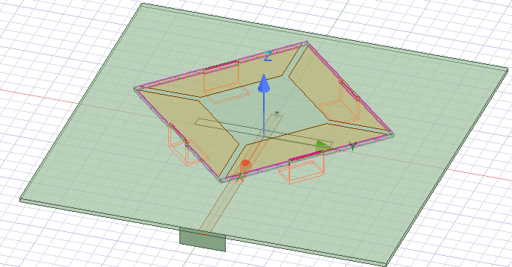
Our Model

Slide 11
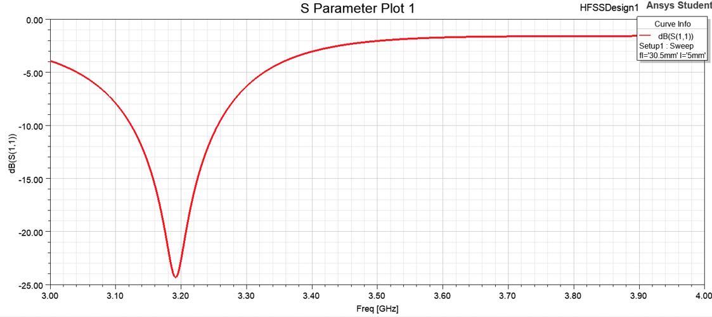
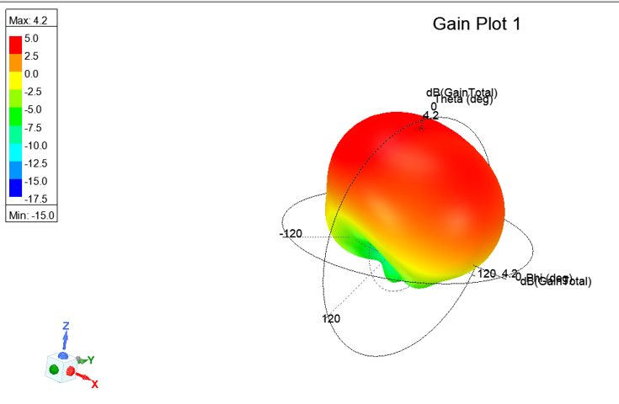
LP Simulation

Slide 12
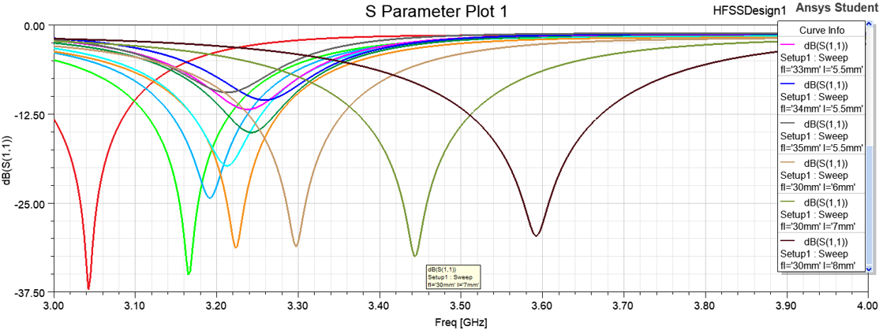
LP Simulation

Slide 13
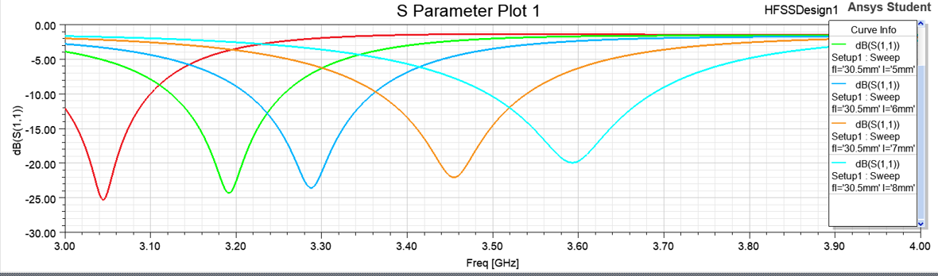
LP Simulation

Slide 14
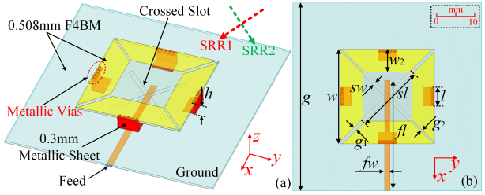
Single Fed CP Antenna
Notes:
Polarization appears to rotate while the signal travels from Tx to Rx. Issue is that they are circular over only a narrow beamwidth.

Slide 15
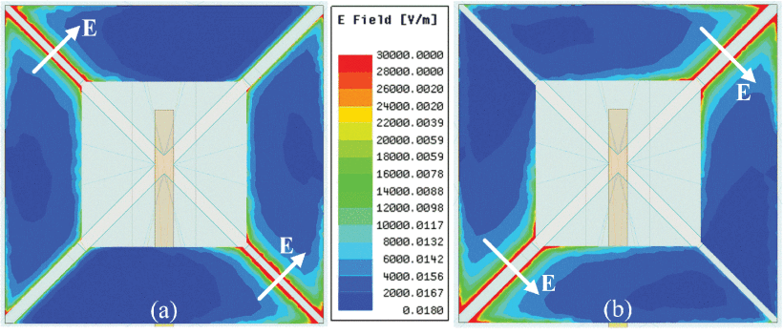
Author’s Simulation

Slide 16
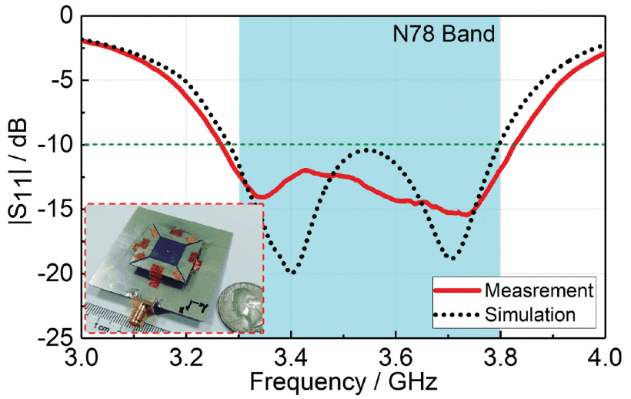
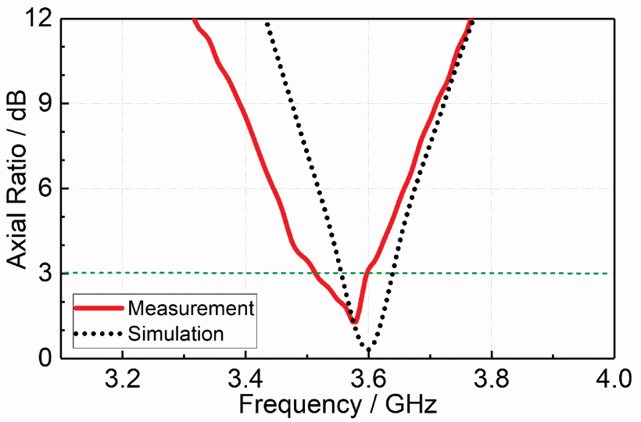
Author’s Simulation

Slide 17
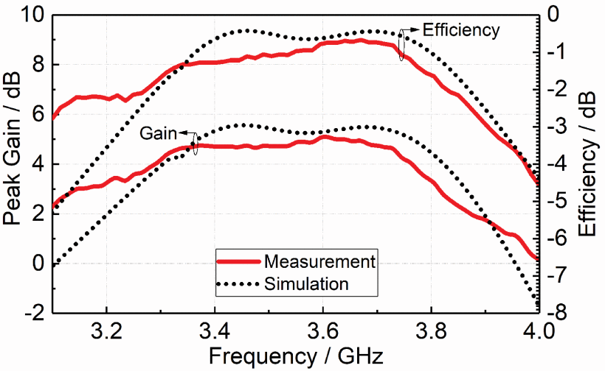
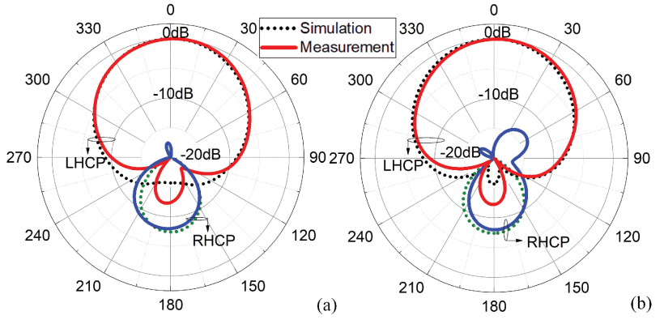
Author’s Simulation

Slide 18
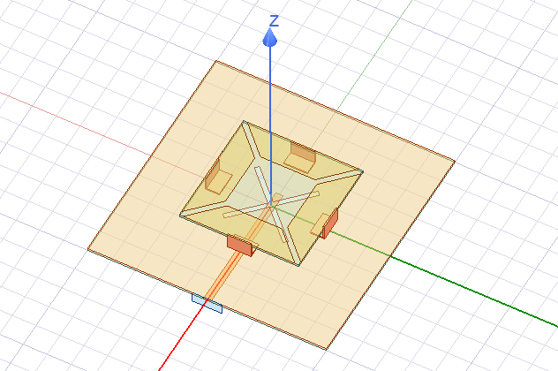
Our Model
Two slots fed by one line into cross structure
We tune gaps on top plate to achieve target resonances

Slide 19
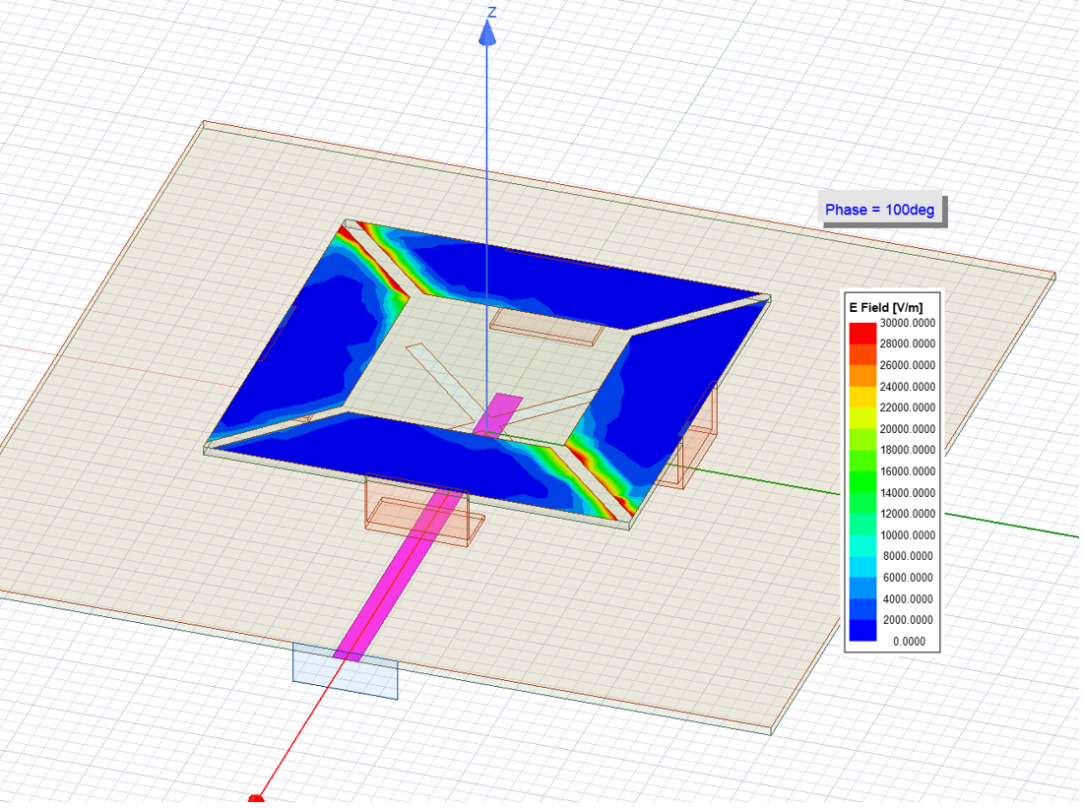
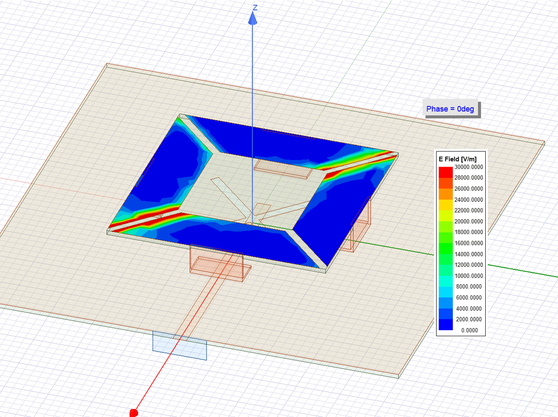
Simulation

Slide 20
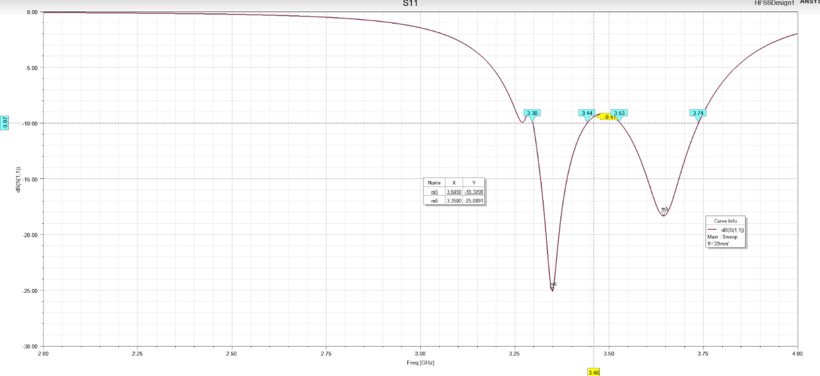
Simulation
Two main dips (3.35GHz, 3.65GHz)
Center of “w” shape around 3.5GHz

Slide 21
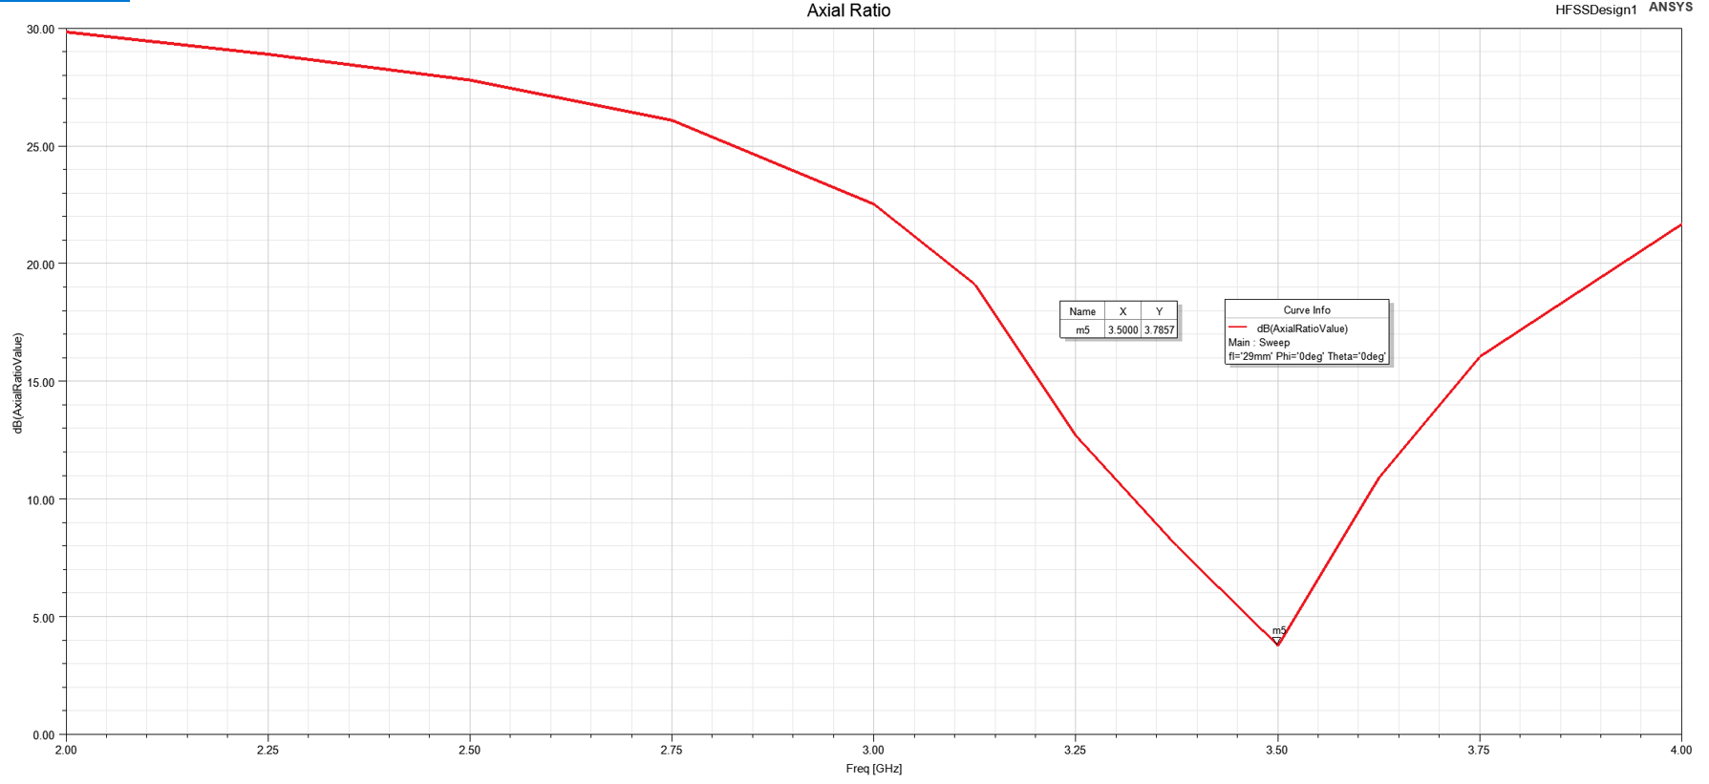
Simulation
Axial ratio minimum at 3.5GHz
3.8dB
Narrow AR band

Slide 22
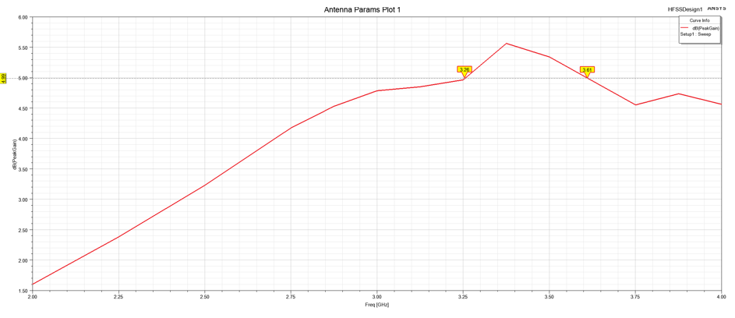
Simulation
Notes:
Still decent gain around our band

Slide 23
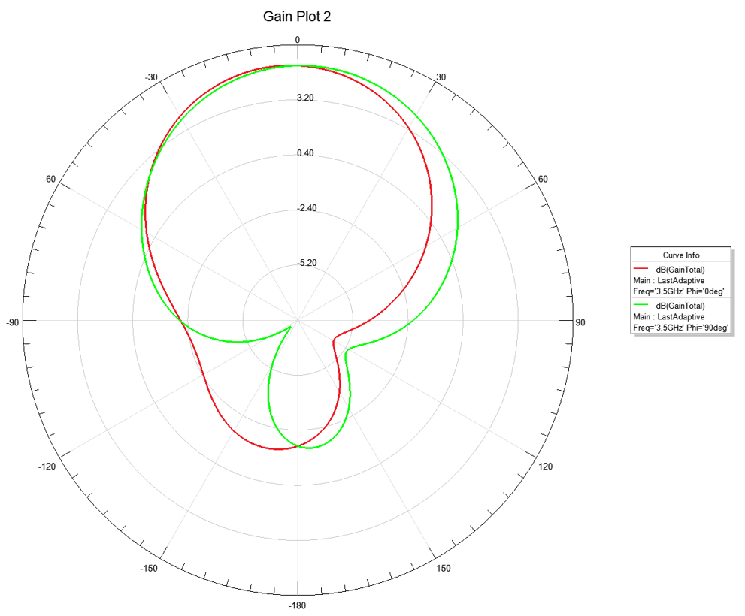
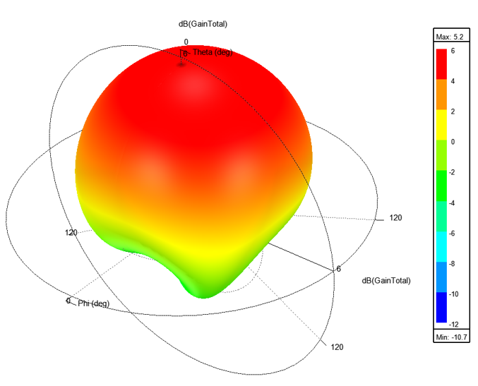
Simulation

Slide 24
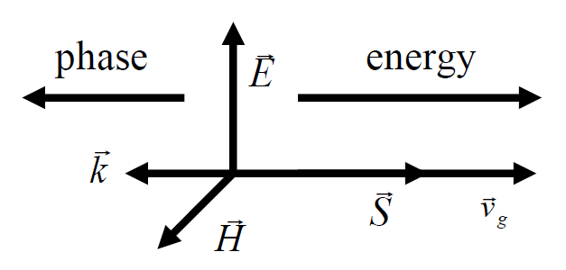
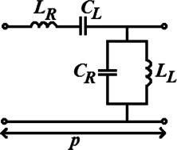
CRLH-TL
Notes:
CRLH-TL: Composite Right-Left Hand Transmission Line. At lower frequencies, it exhibits LH and at higher frequencies , it exhibits RH. Itoh realized that left handed nature can be realized through CRLH as opposed to, metamaterials consisted of
ROD and SRR are difficult to be applied as they have higher
losses and narrow bandwidths.

Slide 25
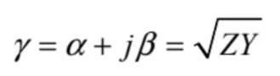
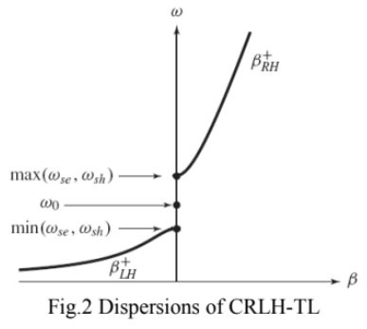
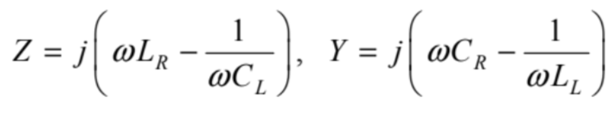
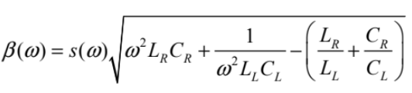
CRLH-TL
Notes:
CRLH-TL: Composite Right-Left Hand Transmission Line. At lower frequencies, it exhibits LH and at higher frequencies , it exhibits RH.

Slide 26
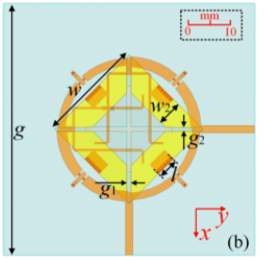
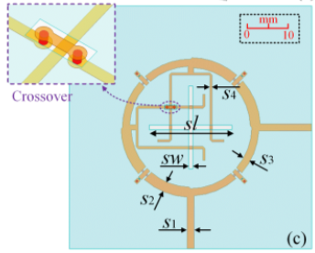
Dual Fed CP Antenna
Top view
Feeding network
Notes:
This is the original

Slide 27
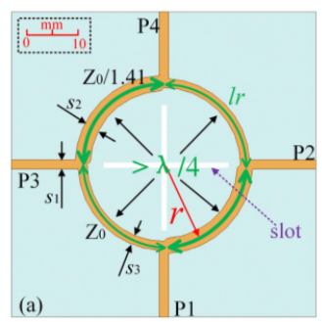
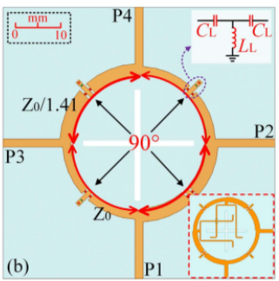
Dual Fed CP Antenna
Original Feeding Network
CRLH-loaded Feeding Network
Notes:
This is the original

Slide 28
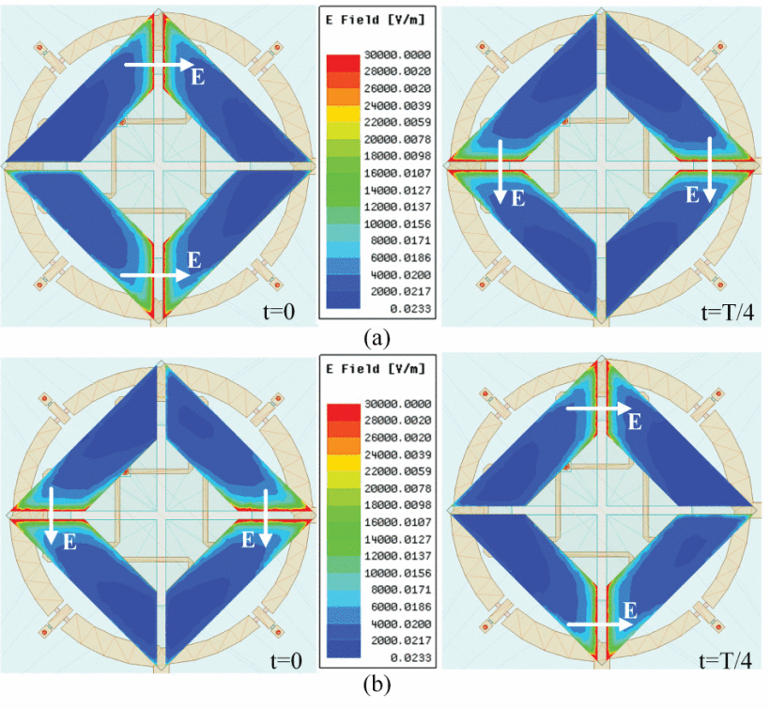
Author’s Simulation

Slide 29
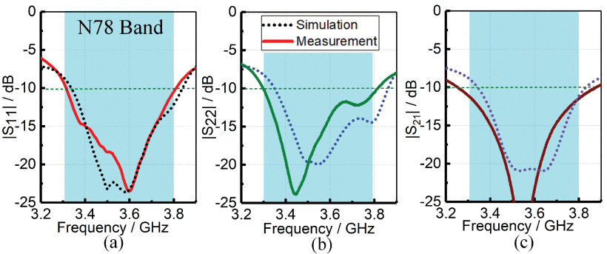
Author’s Simulation
Observe two resonances from S11 & S22
Main resonance at center frequency in S21

Slide 30
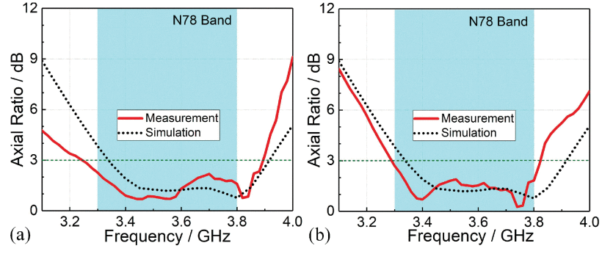
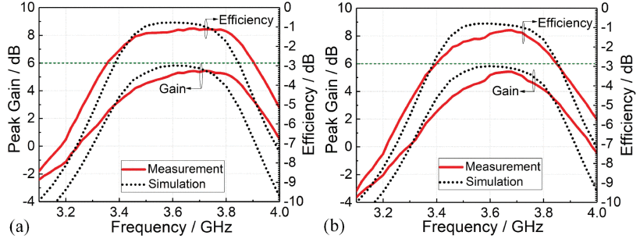
Author’s Simulation
Wider AR bandwidth
Good performance

Slide 31
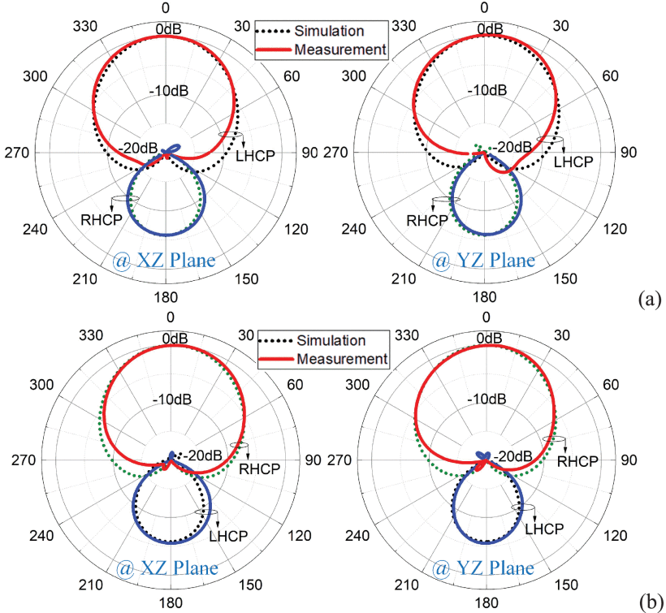
Author’s Simulation

Slide 32
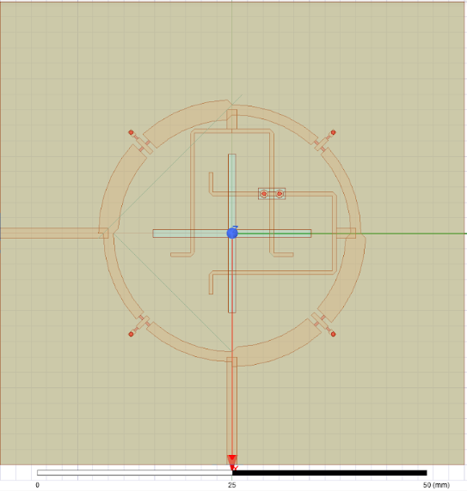
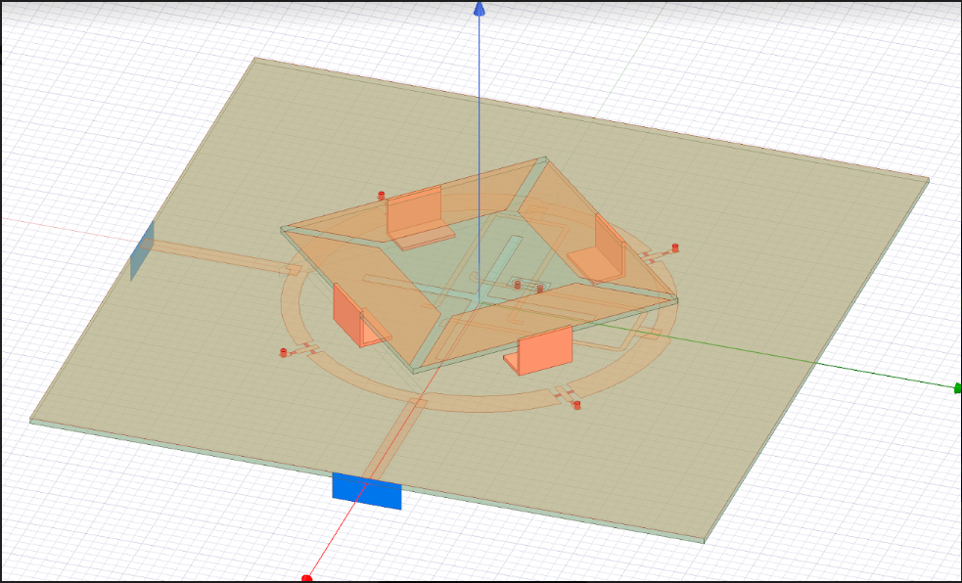
Our Model

Slide 33
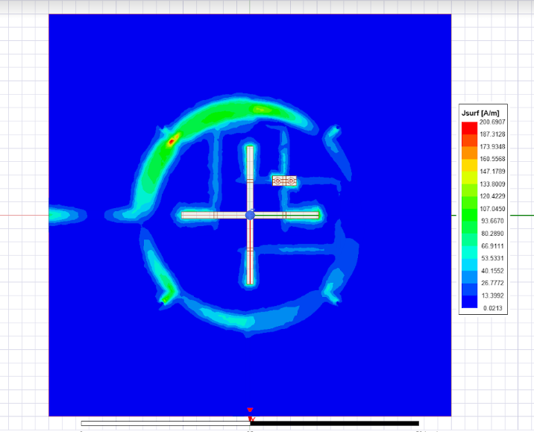
Simulation

Slide 34
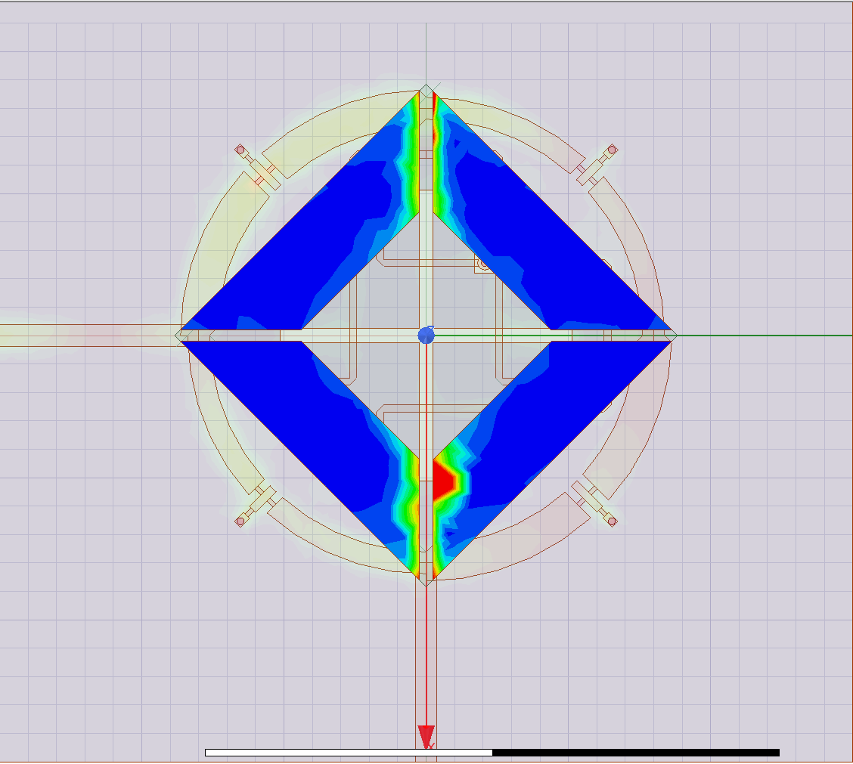
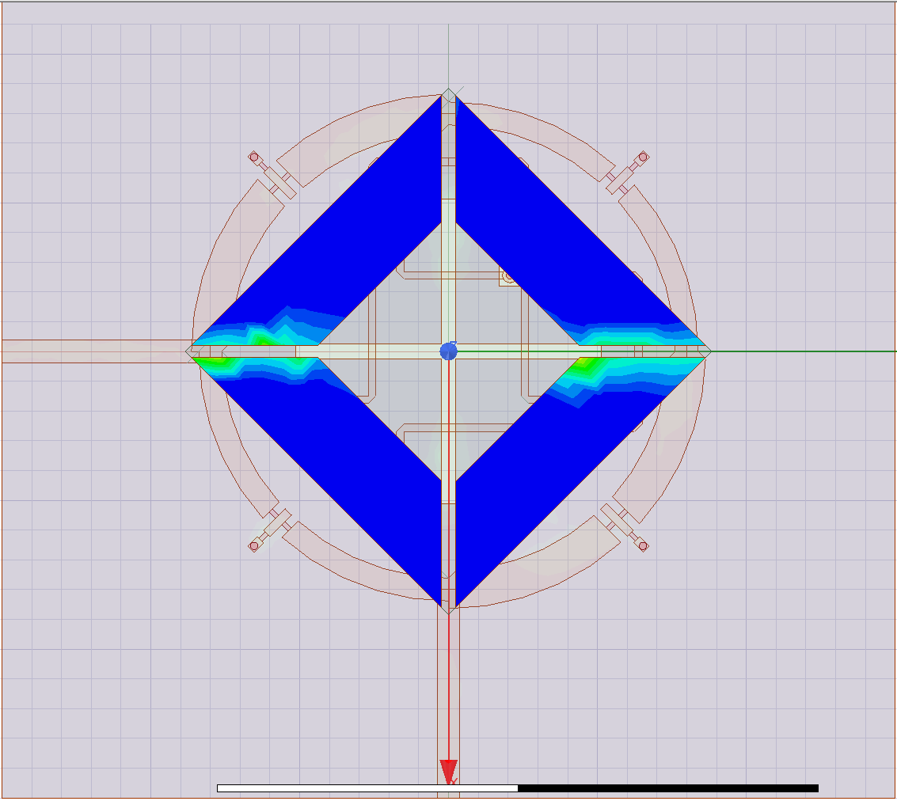
Simulation

Slide 35
Thank You

